Slide 1

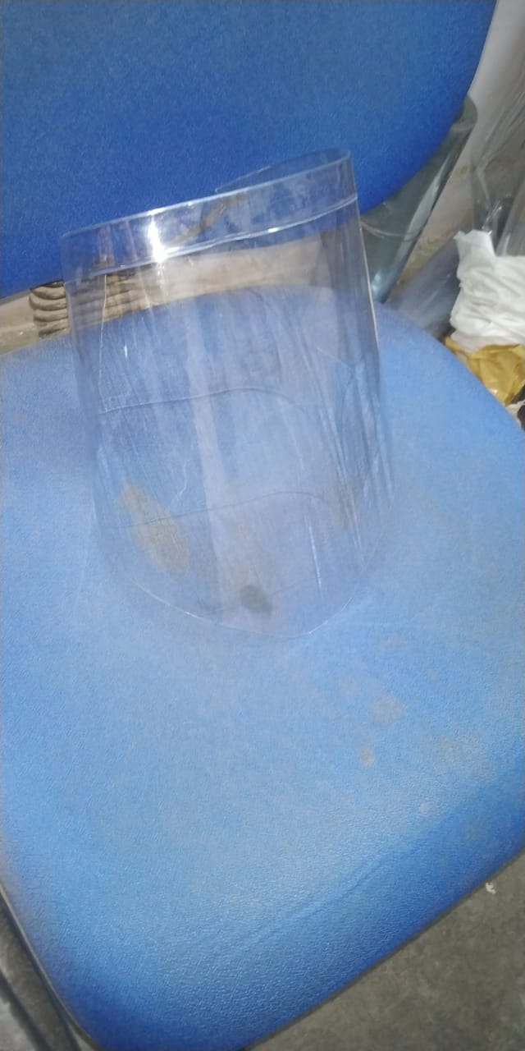
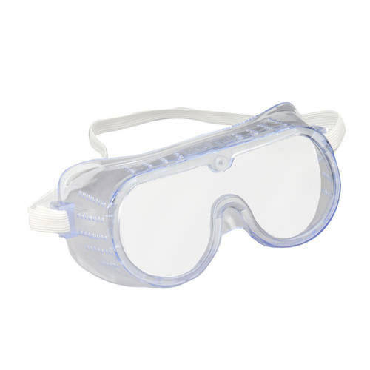
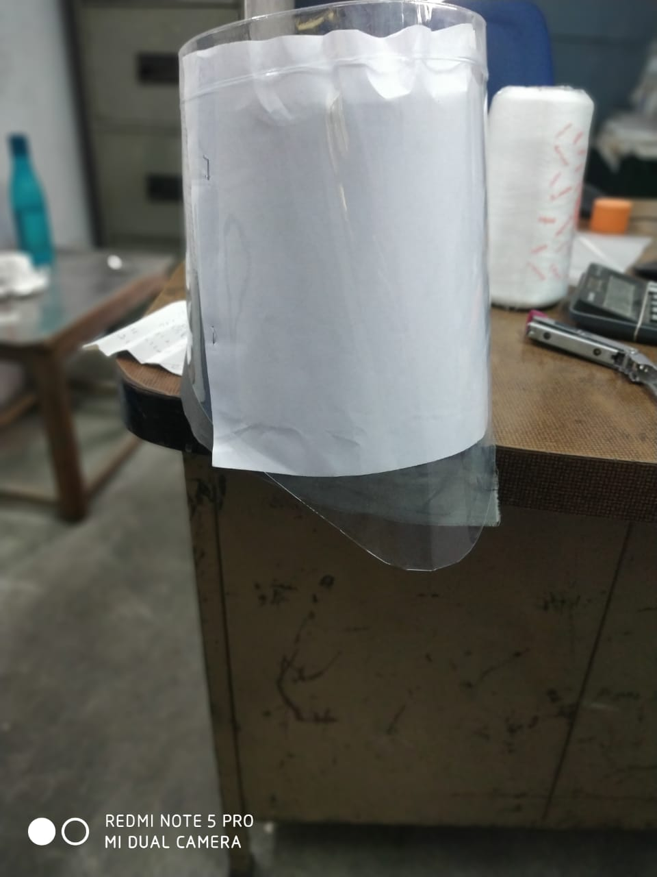
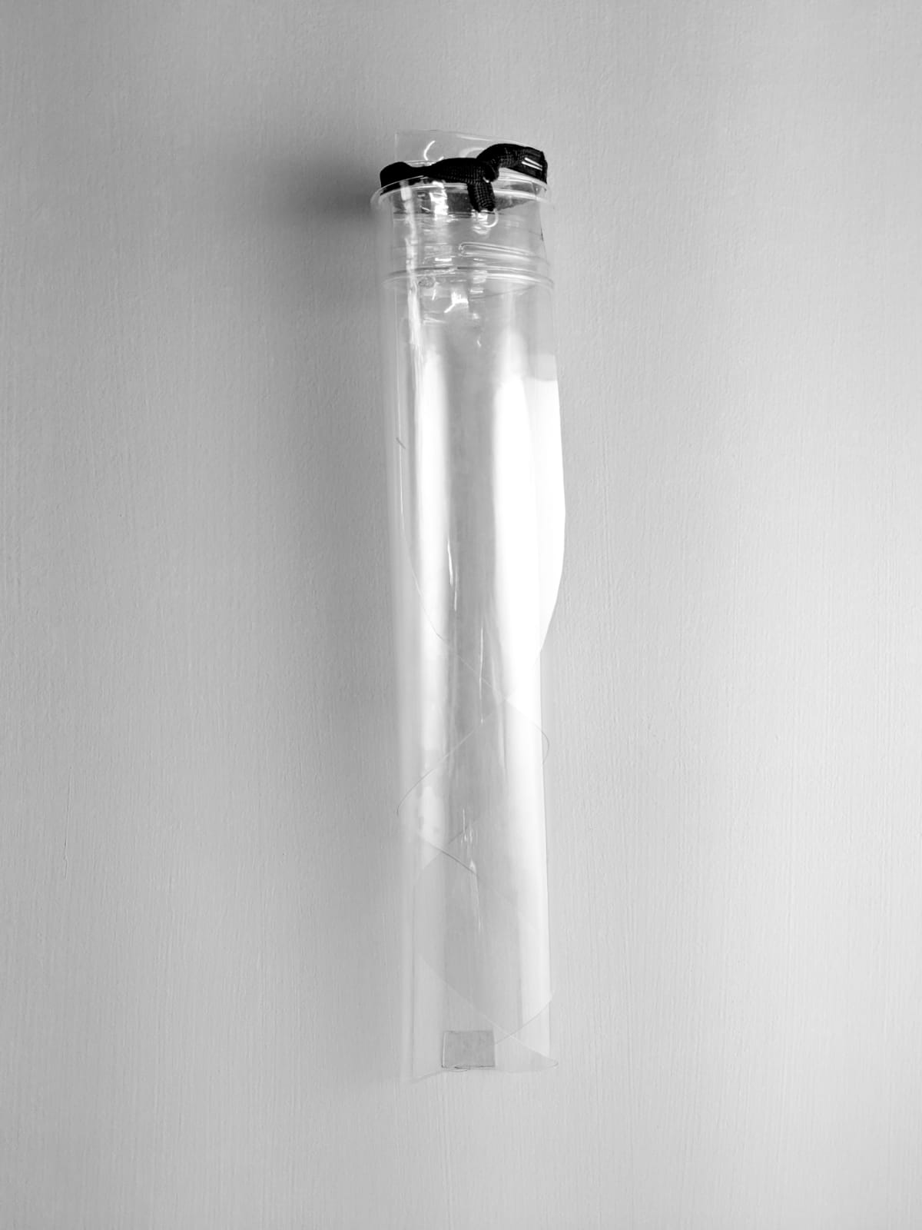
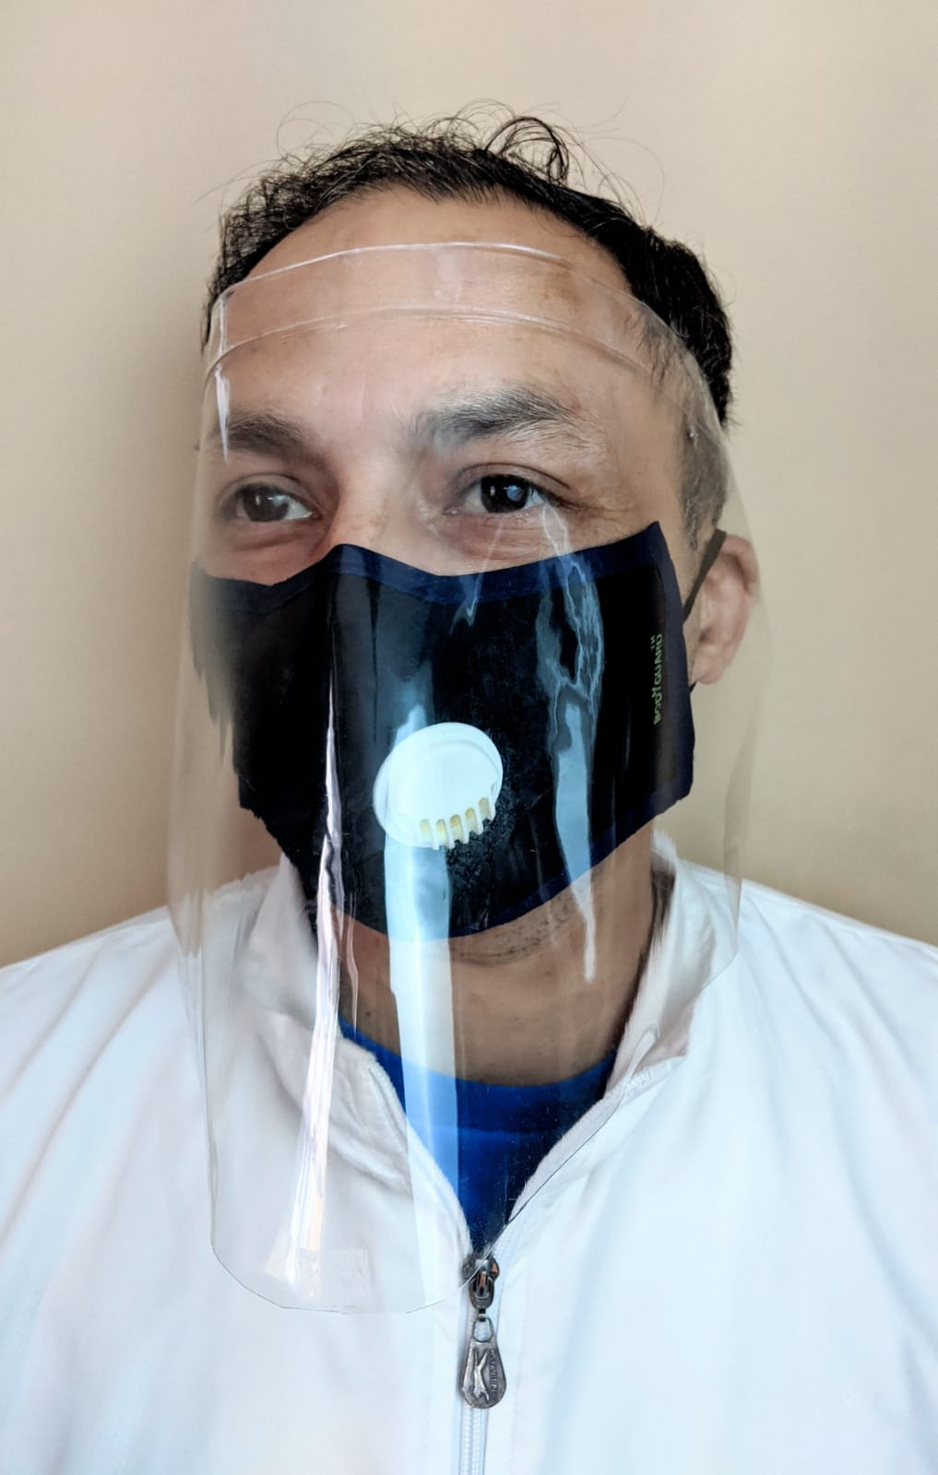
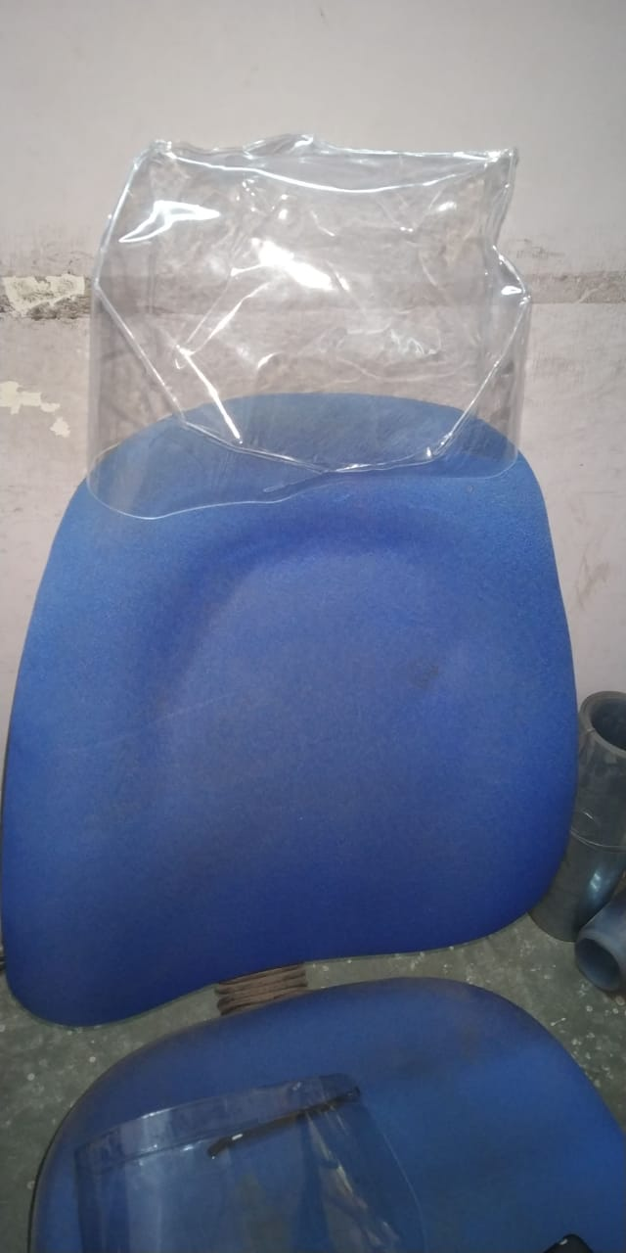
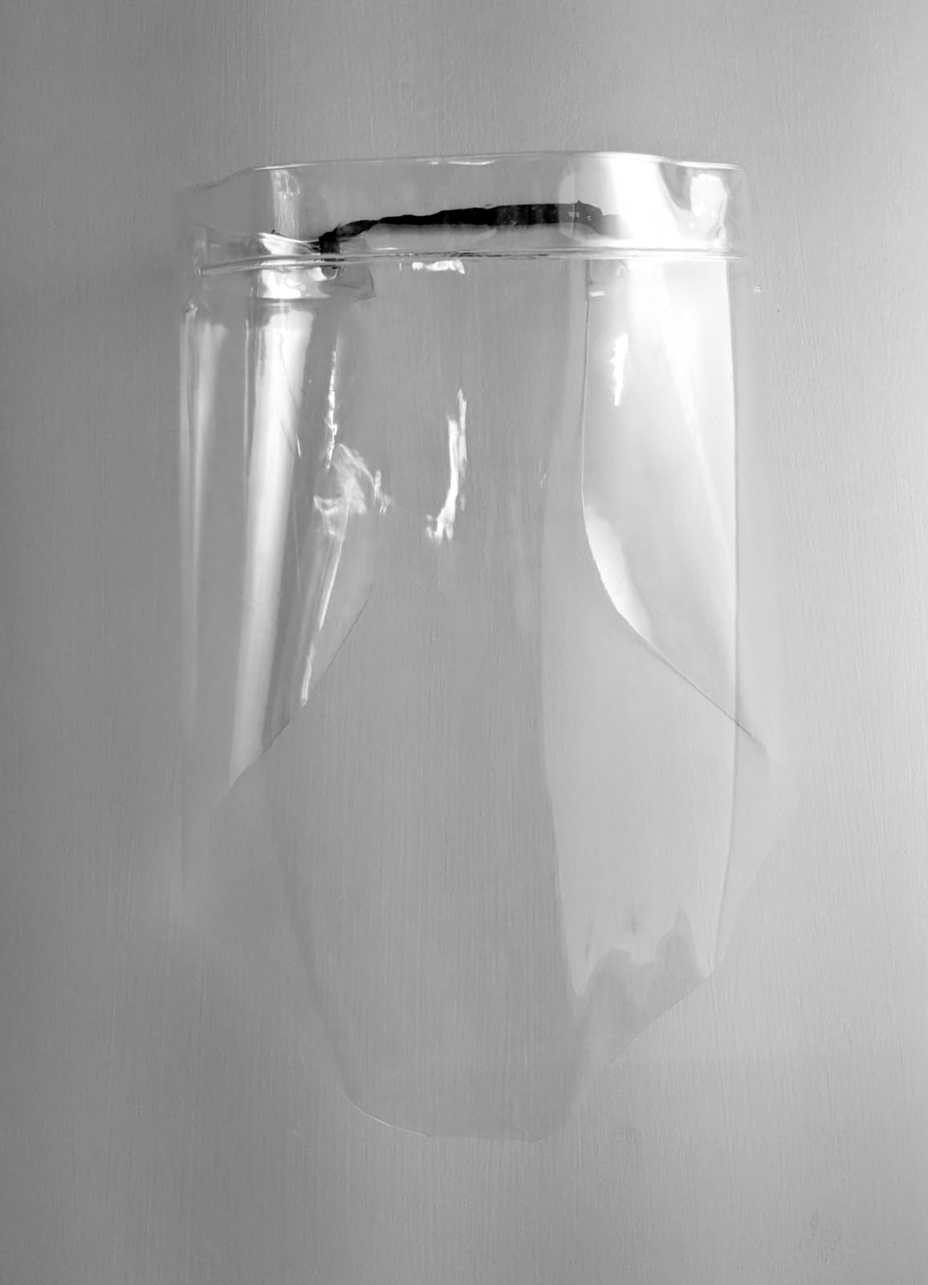
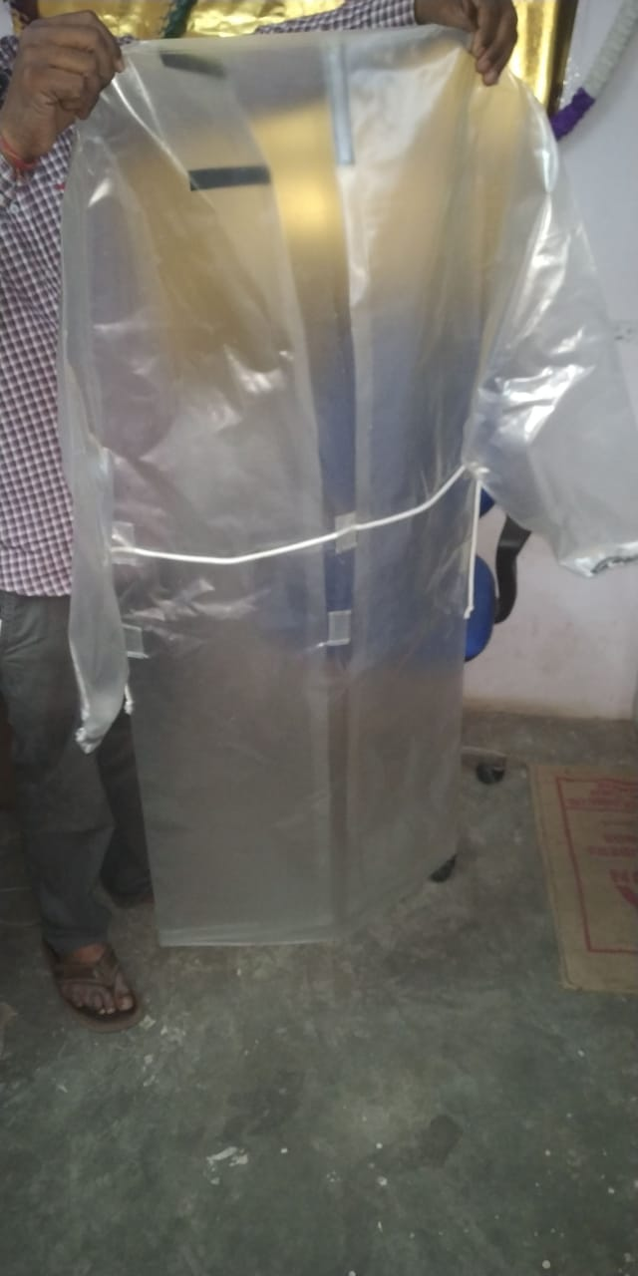
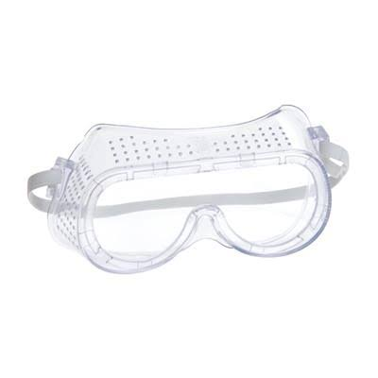
Medical & Emergency Equipments
We offer a light weight, pre-sterlized economical Surgical drape set. Each of these contains Anti Germanic protection for exclusive wear while doing general as well as dental surgical procedures. These are especially high profiled Aprons made out of AAIPL GSM Material to feel free without any heaviness while doing surgical procedures. These are wrapped in a clear poly bag. The surgeon’s gown provided is made in such a way to give you a waterproof design. This drape set is a must have for all medical professionals who prefer for quality and standards.
In today’s time of Corona disease spread, people may use it to isolate themselves from outside environment to maintain personal hygiene and protection like when they go to buy groceries, milk, medicines etc.
Features & details
SURGEON GOWN 1 PIECE
SURGICAL NOSE MASK 1PIECE
HAND TOWEL 1 PIECE
TROLLY DRAPE SHEET 1 PIECE
PATIENT DRAPE SHEET(small) 1PIECE
SURGICAL GLOVES 1 PIECE
HEAD CAP 2 PIECE
LIGHT HANDLE COVER 1 PIECE
RUBBER BAND 4 NOS
SUCTION COVER 1 PIECE
Cost : Rs. 2250/-
Three ply mask daily 1lac pcs
Cost @₹9.6/- per pcs
Medical Visor - 500 pcs a day
Cost @ ₹180/- Per Pc
Medical Glasses: Daily production is 2,000 pieces. Stock - 200,000 pieces.
Cost @ ₹85/- Per Pcs
CONTACT
WA : +91 9724022068

